Slide 1
Welcome

Slide 2
Your expectations and feedback
https://www.menti.com/alqhraaxmdf2
www.menti.com
code: 7465 9056
click: JOIN

Slide 3
Agenda
10-11:30
Continence issues for children with EHCPs or in a special school – bladder and bowel issues
Sharing Knowledge
Top Tips
Things to try at home
Q&A
1130-1230
Local Service Marketplace and opportunity to feed back to us.
Please get as much help and advice as you can from today – no question is a silly question.

Slide 4
Oakdale School

Slide 9
Continence in SEN Children
Dr Joy Harris Consultant Clinical Psychologist
Dawn Bennett-Painter Complex Needs Nurse Team Leader

Slide 10
Common Myths about continence in SEN children
Children with SEN cannot become continent
If a child is unaware of their toileting needs, they can never become continent
If a child cannot undress themselves and sit on the toilet unaided, they will never be continent
If a child is scared of sitting on the toilet/pooing/weeing, they will never be continent
“Free” pads are the answer to all your child’s continence needs

Slide 11
Children with SEN can and do become continent
They may never be completely independent: they may rely on others to prompt them, or offer them practical help with using the toilet.
However becoming even partially continent can help someone to feel more comfortable, suffer fewer conditions such as constipation and UTIs, and feel more dignified.
If your child has an EHCP, check if continence is in there, or think about having it added, so you can get some help with this.

Slide 12
Children who have no awareness of bodily needs can become continent
Routine and consistency are the way forward.
Toileting is a habit which can be taught. Train your brain to go at certain times.
Habits become associated with other habits so after a while they become automatic.
Habits need to feel rewarding in some way to motivate us to keep doing them. If the behaviour is not rewarding in itself, we need to add something pleasant to the habit or change the environment to make it rewarding.

Slide 13
Children who need help to undress and sit on the toilet can become continent
Routine and consistency are the way forward.
Toileting is a habit which can be taught. Train your brain to go at certain times so you can predict when you will need to go.
Teach the child to communicate when they need to go, either verbally or by using sign language, or picture cues.
Even if the young person needs help to use the toilet, being continent in between can help with their physical health, confidence, and dignity.

Slide 14
If the child is scared, use systematic desensitisation to help them overcome their fear.
Thing about what they can do and build on this: really slowly at first.
If a child is scared to sit on the toilet, try sitting for a second at a time to begin with, then 2 seconds etc. offer rewards that motivate your child.
If sensory difficulties make the bathroom scary, then change the bathroom: dim the light, put lots of towels/rugs in to dampen the sound, put things in there to distract them/help them to feel safe, use warm seat covers, put loo roll in the pan to reduce the splash.
Use social stories, PECS, and picture cues.

Slide 15
Pads are not the answer
Pads are not “free”: Tameside spends over a £100,000 a year on them!
Giving your child a pad gives them and people around them the message that you don’t expect they will ever be continent.
Pads may be easier in some ways for carers but uncomfortable for children. They also increase the risk of constipation and UTI’S.
Pads are often so absorbent that the child never gets to learn that they have soiled or wet and this can delay them becoming continent. However ads can also leak and soil clothes.

Slide 16
Hearing that other people get pads makes people want pads for their child. Sharing news that children can and do become continent gives other parents hope.
Find out more:
Potty training children with additional needs – ERIC
Resources for bladder and bowel problems in children

Slide 17
Any Questions?

Slide 18
Your expectations and feedback
https://www.menti.com/alqhraaxmdf2
www.menti.com
code: 7465 9056
click: JOIN

Slide 19
Thank you

Slide 20
Welcome

Slide 21
Your expectations and feedback
https://www.menti.com/alee6i296ch7
www.menti.com
code: 3347 6421
click: JOIN

Slide 22
Agenda
12:30-2:00
Continence issues for all children (night time wetting and constipation) – bladder and bowel issues
School readiness
Support and knowledge sharing around night time wetting and constipation
Top tips for you to take away and try at home
Q&A
2:00-2:30
Local Service Marketplace and opportunity to feed back to us
Please get as much help and advice as you can from today – no question is a silly question.

Slide 23
What is School Readiness?
Notes:
Explain what we mean by school readiness

Slide 25
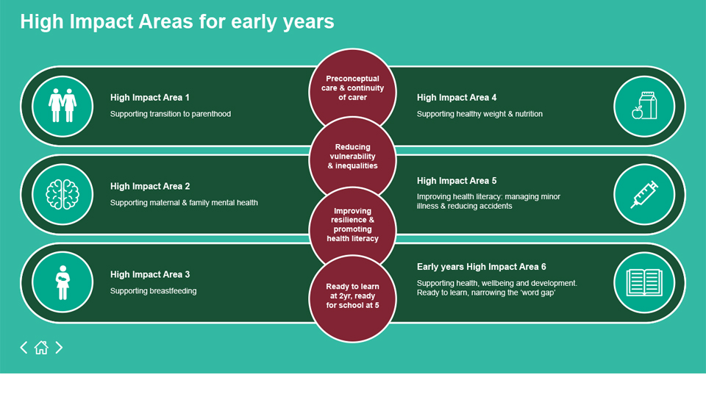

Slide 26
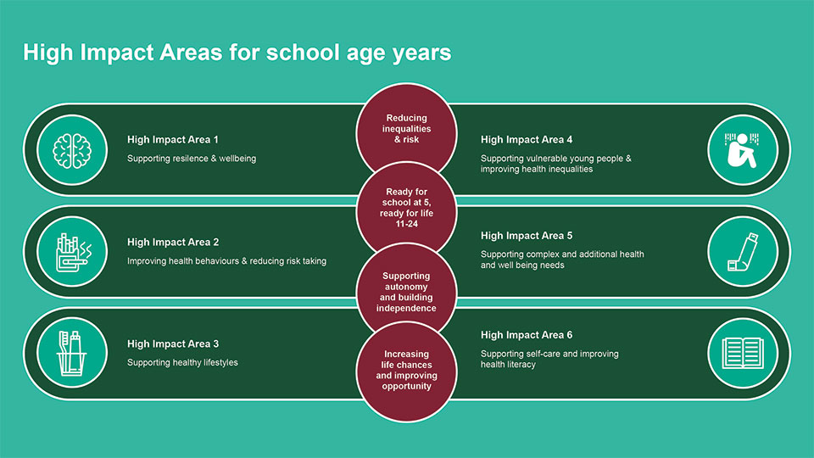

Slide 27
Parents and carers are the child’s greatest teacher and role model.
Notes:
Never forget how much your child learns from the beginning

Slide 28
Ready to separate… I will be ready for school when... • I can feel secure and separate from my parent or main carer • I can say goodbye to you when I have a grown up I know to help me
• Give me the opportunity to go to groups and meet other children
• Give me experiences of being left with other adults and family members
• Take me to children's centre groups, toddler groups, pre-school/Nursery
• Give me the chance to talk to new grown-ups when you are there

Slide 29
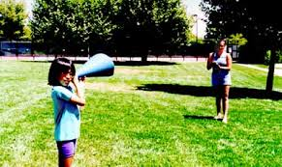
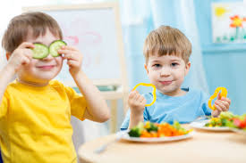
Ready to Communicate… • I can express myself if I need something • I can communicate my own ideas, needs and feelings • I make observations, comment and ask questions • I can use words about things that interest me • I can talk about lots of different things; what I’ve done, who I’m with or where I’m going • I use objects or gestures to help me explain what I am talking about
Notes:
• Give me time to join in when sharing a book • Talk to me about the sounds I hear when we go to the shops or the park • Give me the opportunity to make choices about what I might like to eat or play

Slide 30
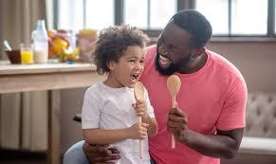
Ready to listen. . • I am interested in my own play and the world around me • I can follow developmentally appropriate instructions • I join in with singing songs and rhymes • I join in with my favourite bits of the story • You ask me to do something like ‘come and put your coat on’ I will do it if I am not too busy playing
Notes:
• Give me experiences of sharing books and
singing rhymes
• Give me the opportunity to play listening games
• Give me time to respond to a question

Slide 31
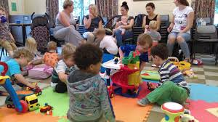
Ready to socialise. . • I can interact in an age/developmentally appropriate way • I can share and play and I am beginning to take responsibility for my actions • I am beginning to be able to tell my friends what they could do to help me if they take my toys or make me upset or cross
• Take me to groups to meet other children
• Give me time to chat to my friends and my
family about the things I know
• Sometimes I know that my friend will want to have the toys I am playing with and I need help from a grown up to help me share these with them

Slide 32
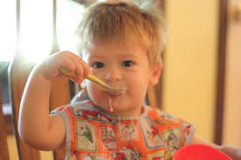
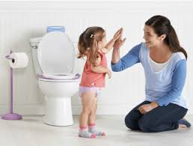
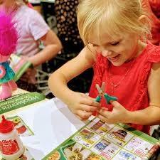
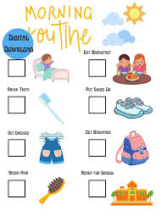
Ready to be independent. .
Notes:
• I can wash and dry my hands by myself
• When you help me and hold out my coat I
can put in my arms and I can do the zip up
when you start it
• I can hold a spoon and feed myself
• I will go to a grown up I know when I’m
feeling sad, scared or worried
• I can sometimes stop myself from doing
something I know I shouldn’t be doing
• I can follow simple routines to help me do
things by myself
• I choose the toys I want to p

Slide 33
Contact your Health Visitor or School Nurse if you need more information

Slide 34
Let's Talk About
Toilet Training
Tameside Health Visiting Service

Slide 35
The Right Time
Children can be ready anytime between 18 months and 3 years, which is a huge range of time in your child's life.
The 'right time' for you and your child is the right time.
You and your family are an important part of this process, and you need to consider whether you are physically and emotionally available to support you child.
If you are busy with a new baby or a new house, then it may not be the right time and that's ok!

Slide 36
Preparation
Think about your child's habits.
Do they often go at the same time each day?
Talk about using the toilet
Encourage your child to associate the toilet with weeing and pooing Take them to the toilet with you when you go and change nappies in there if possible

Slide 37
Disposable Nappies
Disposable nappies are designed to hold a large amounts with minimum discomfort. This is great ! Until you want your child to know when they're going! Consider using a paper towel inside the nappy so your child feels they are wet

Slide 38
Think About Drink
Hydration is an important part of establishing a healthy toilet routine. Your child should have 6-8 drinks each day.
Water - still, unflavoured
Full fat cows milk or dairy free alternative.
Well diluted fruit juice, cordial or flavoured water
Caffinated drinks - tea or coffee
Fizzy drinks

Slide 39
Getting Started
Ditch the Nappies
Toilet Trips
Yes, even if they are pull ups. Your child needs to understand wetting to know how to prevent it
Don't ask your child if they need to go, they dont have that understanding of holding it in yet. Just take them regularly
Make It Fun
Have toys and books available, sing songs, blow bubbles. If your child likes going to the toilet, they're more likely to go when they need to

Slide 40
When It Goes Right
Praise
Every little step is an important milestone Make sure your child knows how proud you are It's worthy of a celebration!
Rewards
Your words are enough, but some like to give a physical reward. If so, use instant rewards that are sustainable like stickers on a chart

Slide 41
When It Goes Wrong
Keep Calm
Accidents happen! You know that, make sure your child does too. Deal with accidents calmly - clean and change your child and move on. Be prepared with spare clothes when you go out.
And (Try To) Carry On
Try not to jump back to nappies. These things take time and patience. If you do feel your child isn't ready, or your circumstances change and it isn't good timing, go back to full-time nappies. Swapping between will only cause confusion and regression. Try again another time.

Slide 42
Remember....
Toilet Training Is A Team Effort
Consider whether you are ready. If things are a little busy or stressful, wait until things settle, It will be a quicker process and you will be better placed to be the calm, encouraging parent your child needs
Every Child Is Different
Don't compare your child's journey to others around you. Some children learn faster and earlier. If it works for your family, then it's right

Slide 43
For More Information
We've covered the basics, but there is lots more information on the ERIC website. ERIC are a children's bowel and bladder charity. ERIC provide information and resources to support with toilet training. They also provide support for families who have children with additional needs, either physical or emotional. So, if you want to know anymore, visit their website. You can also contact your health visiting team if you feel you need support.

Slide 44
Any Questions?

Slide 45
Enuresis – Bedwetting
Kaylie Sims
Enuresis Specialist Nurse

Slide 46
agenda
Introduction 3
Basic Tips & Referrals 4-6
Treatments 7
Daytime Wetting 8
Questions & Contacts 9-10

Slide 47
Introduction
Enuresis means nightime wetting
It is very common and affects 1 in 15 seven-year-olds and 1 in 75 teenagers. It does run in families but its no one's fault.
You don’t have to wait for children to grow out of it. Along with some basic steps, there are treatments available from 5 years old.
In Tameside we have an Enuresis service so you can get a referral to see the Specialist Nurse

Slide 48
Basic Tips
Drinking
Rule out constipation
Good bedtime Bedtime routine
Try without pullups
Protect the bed

Slide 49
Assessment
If you have tried all the basic tips and wetting is still an issue. You can get a referral to the Enuresis clinic at Ann Street clinic in Denton. There are two ways you can do this.
School Nurse
GP.

Slide 50
Criteria for a referral
Over the age of 5
Toilet Trained
Attend a Tameside School.

Slide 51
Treatments
Bed Alarm
Desmomelts

Slide 52
Daytime Wetting
Children wetting in the daytime is very common. Although the Enuresis service is limited in terms of assessments and treatments. Advice and support can be given on good bladder health.
Rule out constipation – Check poo is soft and easy to pass, children should poo between 3 times a day and 4 times a week.
Drinking - What we drink and how much plays a big part in how your bladder behaves.
Void regularly throughout the day. Vibrowatches can help.
Relax to wee – Respond straight away and sitting is fine.

Slide 53
Any Questions?

Slide 54
Thank you
Kaylie Sims

Slide 55
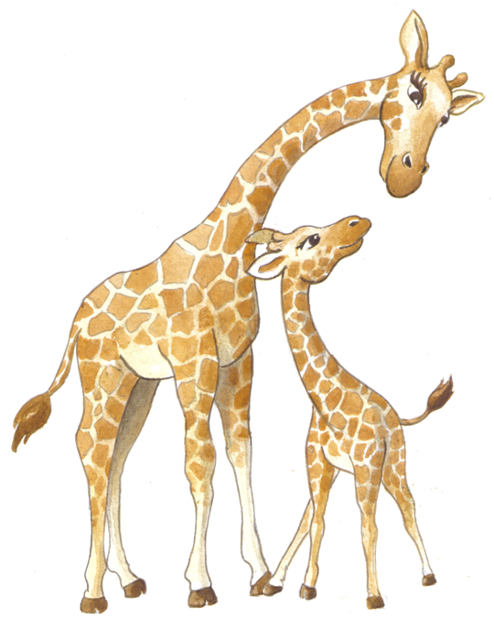
Constipation
Dr Joy Harris, Consultant Clinical Psychologist
Jess Oakes, Children’s Community Team manager

Slide 56
Common Myths about Constipation
Constipation is due to poor parenting and lazy children
Constipation means you can’t poo
Laxatives are dangerous and shouldn’t be used regularly
Constipation can be cured if you eat healthily
Don’t google information about health, it just makes you worry

Slide 57
Constipation is a genetic chronic health condition
Constipation lasting longer than three months is a chronic health condition (like asthma, epilepsy, diabetes etc).
It is a genetic condition affecting 1 in 3 children therefore no-one’s fault.
However there are lots of things you can do about it and the most important is educating yourself and your child.
This Photo by Unknown Author is licensed under CC BY-ND

Slide 58
Chronic constipation often causes overflow which can lead to frequent leaking and soiling

Slide 59
Laxatives are the best and safest way to treat constipation.
Consistency is the key, it can take months or even years for the bowel to shrink back to its normal size and laxatives are essential.
Find out what laxatives can be used and how to use them
A parent's guide to disimpaction – ERIC
Learn how to adjust the dose and experiment until you find the right amount, then use it for as long as necessary.
Teach your child that regular toileting is crucial whether you “need” it or not. You have to retrain your brain.
This Photo by Unknown Author is licensed under CC BY-SA-NC

Slide 60
A healthy diet is good for your body but is not effective in treating constipation.
Constipation is genetic and increasing fibre is not an effective treatment.
However, making healthy choices about food is a good habit to get into
The Eatwell Guide - NHS
This Photo by Unknown Author is licensed under CC BY-NC-ND

Slide 61
Do Google but use reputable sources
Overview | Constipation in children and young people: diagnosis and management | Guidance | NICE
Constipation in children: symptoms, causes and relief – ERIC
A parent's guide to disimpaction - ERIC
The Poo in You - Constipation and Encopresis Educational Video
Resources for bladder and bowel problems in children

Slide 62
Any Questions?

Slide 63
Your expectations and feedback
https://www.menti.com/alee6i296ch7
www.menti.com
code: 3347 6421
click: JOIN

Slide 64
Thank you

